Slide 1
Welcome Back!
Don’t forget to take a tissue to wipe down your desk…
Please do not sit at desks with boards.

Slide 2
IB English Language and Literature
6 ELL SL 4
2019 - 2020
Shape of the Week (3):
Lesson 1: Paper 2 Revision Structure and Planning Whole Paper
Lesson 2: Exam questions spreadsheet and planning (shared doc).
Lesson 3: Exam questions spreadsheet and planning (shared doc).

Slide 3


SCHOOL ASSESSMENT TERM 4
☑ NOTHING!

Slide 4
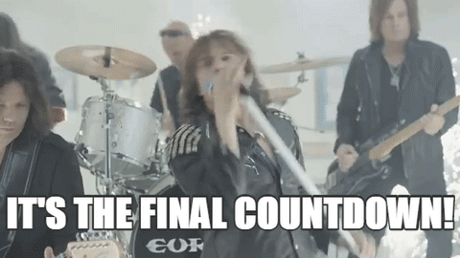

Slide 5

Homework
In pairs (please do not join a pair for this activity), go through the first 5 activities on the handout below, sending them back through Firefly - let me know who you were working with at the top of the page… Use the Google Table handout to help. Please remember that each pair should pick a different essay. There are plenty to go around. Homework: write up the essay - I will be back on Tuesday and will mark anything you have for me.

Slide 6
General Outline Term 4
Week 1: 14th-18th September
Lesson 1: Recap ‘Big 5’ and Text Types.
Lesson 2: Planning, paper 1 structure and annotation of example. Complete past paper (HW).
Lesson 3: Marking peer exam paper 1 and go through the mark schemes.
Week 2: 21-25th September
Lesson 1: Revision of main ideas/themes/issues presented in ‘1984’.
Lesson 2: Revision of main ideas/themes/issues presented in ‘COADF’.
Lesson 3: Structure and planning for paper 2. Complete exam questions (HW).

Slide 7
General Outline Term 4
Week 3: 28th Sep- 2nd October
Lesson 1: Marking peer exam paper 2 and go through the mark schemes.
Lesson 2: Exam questions spreadsheet and planning (shared doc).
Lesson 3: Exam questions spreadsheet and planning (shared doc).
Week 4: 5th-9th October
Lesson 1: Final Paper 1 + 2 Revision

Slide 8

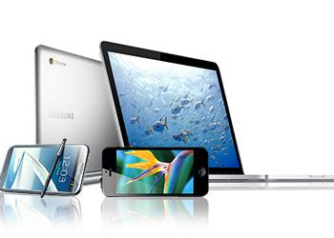

We are still a digital classroom!

Slide 9
Complete Essay Plans

Slide 10
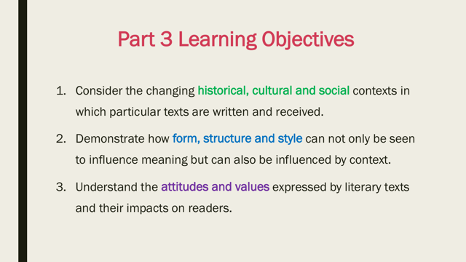

Slide 11

Go to Google Classroom
In Pairs…
Fill out the COADF side of the Revision Table, as directed yesterday. Today, you will need to decide which pairs fill out which sections. Don’t forget to put your names to your sections.

Slide 12
Homework
Complete Paper 2, Preferably under timed conditions.

